Slide 1
Saving on a low income: Programs and strategies that work
December 6, 2018

Slide 2
Welcome!
Thank you for joining the webinar on Saving on a low income: Programs and strategies that work hosted by Prosper Canada.
The presentation will begin shortly. (Audio will begin when the presentation starts)
Technology details:
For technical assistance, call GoToWebinar support line: 1-855-352-9002
Participants should connect using VOIP.
Please check that the volume is turned up on your computer.
If dial in option is required, please dial in as follows:
Tel (Canada): +1 (647) 497-9429
Access Code: 636-570-048
Toll free option not available

Slide 3
Webinar logistics
Audience members have all been put on “mute” for this webinar
Please share any questions you have using the “Question box” (located in the control panel at the right side of your screen).
You’ll find a few handouts you can download and refer to during the presentation (located in the control panel at the right side of your screen)
We will share webinar slides with all participants and post a recording of the session following the webinar.
Tweet with us at #prosperwebinar @prospercan

Slide 4
Prosper Canada – Who we are
Founded in 1986, Prosper Canada is a national charity dedicated to expanding economic opportunity for Canadians living in poverty through program and policy innovation.
As Canada’s leading champion of financial empowerment, we work with governments, businesses and groups to develop and promote financial policies, programs and resources that transform lives and foster the prosperity of all Canadians.
Prosper Canada’s programming in financial literacy and financial coaching is part of the work of the Prosper Canada Centre for Financial Literacy, co-founded and supported by TD Bank Group.
We help service systems and organizations in all sectors to build proven financial empowerment approaches into their businesses in ways that:
Are sustainable
Help them achieve their goals
Tangibly increase the financial well-being of the low-income people they serve.
Notes:
My name is Glenna Harris, and I am Manger of Learning & Training here at Prosper Canada.
Prosper Canada works with partners in all sectors to ensure that all Canadians, regardless of their income, have access to the financial programs, products, services and advice they need to build their financial well-being.
We envision a future in which all vulnerable Canadians have access to free, high-quality, and unbiased financial information, education, coaching or counselling when they need it, so we see financial coaching programs as an important part of this vision.
Prosper Canada’s programming in financial literacy and financial coaching is part of the work of the Prosper Canada Centre for Financial Literacy, co-founded and supported by TD Bank Group.

Slide 5
Our speakers
1. Welcome and introduction
2. Why save?
3. Our speakers:
Dean Estrella, Momentum (Calgary, AB)
John Cockburn, Credit Counselling Sudbury (ON)
4. Q&A
Notes:
We have an exciting presentation planned for you today.
Both of our speakers work in the financial empowerment field in Canada, and will tell us about how they approach savings within their programs.
Dean will tell us about different matched savings programs at Momentum, in Calgary Alberta, and the positive results they have had in helping people living on low incomes to save.
And then John will tell us more about the one-on-one approaches he uses with clients in his work at Credit Counselling Sudbury – he uses a variety of different tips in his client centred approach, that also work to help build the savings habit.

Slide 6
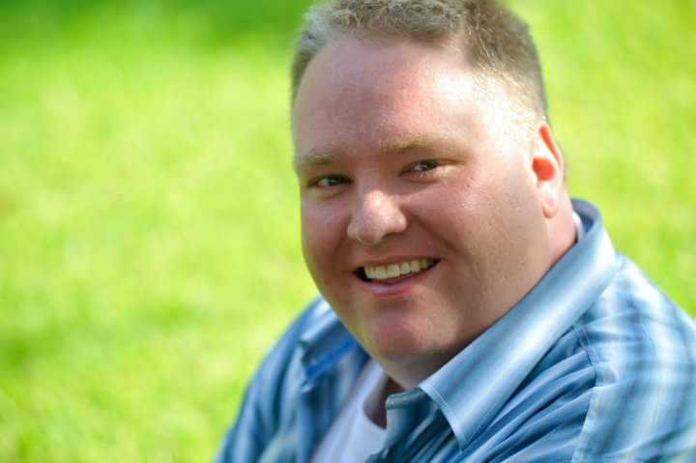
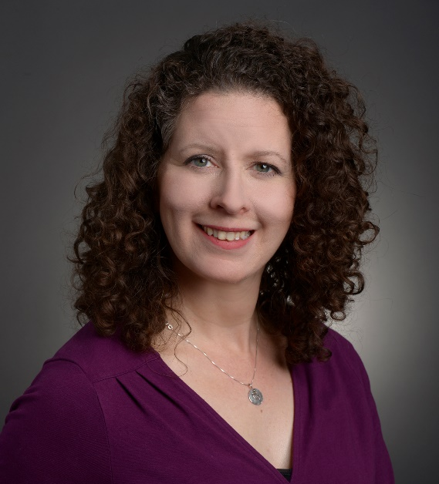
Introductions: Our panel
Dean Estrella
Momentum (AB)
deane@momentum.org
John Cockburn
Credit Counselling Sudbury (ON)
jcockburn@vianet.ca
Glenna Harris
Prosper Canada
gharris@prospercanada.org
Notes:
We are very excited to introduce our panel of speakers to you today!
Dean Estrella is the Financial Empowerment Manager of Asset Building at Momentum, a change-making organization based in Calgary, AB that combines social and economic strategies to reduce poverty. He is a dedicated social worker with a strong focus on partnering with low-income individuals and community agencies to reach sustainable goals.

Slide 7
Financial Empowerment Champions (FECs)
National Financial Empowerment Champions project
5 champions working to improve the financial literacy and health of 175,000+ Canadians on low/modest incomes
Ontario Financial Empowerment Champions project
5 champions working to improve the financial literacy and health of 50,000+ Ontarians on low/modest incomes
Notes:
Momentum and Credit Counselling Sudbury are both part of our Financial Empowerment Champions projects.
The NFEC project supports leading community and non-profit organization and their partners in 5 communities across Canada to deliver a suite of financial empowerment supports to improve the financial literacy and health of 175,000+ Canadians on low/modest income
The OFEC project Supports leading community and non-profit organizations and their partners in 5 Ontario communities to deliver a suite of financial empowerment to improve the financial literacy and health of 50,000+ Ontarians on low/modest incomes.
The joint efforts of all FECs and their partners have resulted in just over 3,000 RESPs opened Since 2016.

Slide 8
Audience poll
Tell us more about what ways you use to help people save
1-on-1 financial coaching or counselling
Financial literacy education
Matched savings programs
Tax-time savings programs
Other
Do you have a savings account?
Notes:
This year, the Financial Consumer Agency of Canada conducted its first survey of financial well-being in Canada. In this research they define financial well-being as the extent to which individuals are able to comfortably meet all of their current financial commitments and needs, while also having the financial resilience to maintain these in the future.
Their key findings showed that one of the most important behaviours that supports financial well-being is saving. Canadians who practice active savings behaviour have higher levels of financial resilience as well as higher levels of overall financial well-being

Slide 9
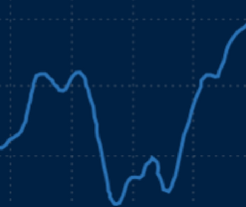
Why save?
Building financial well-being
“Canadians who practice active savings behaviour have higher levels of financial resilience as well as higher levels of overall financial well-being.”*
Important for people living with low income and fluctuating income
Build a financial “cushion” for tight times
Look for “spikes” in the year to save more when the “dips” come along
*FCAC. Preliminary findings from Canada’s Financial Well-Being Survey. 2018.
https://www.canada.ca/en/financial-consumer-agency/programs/research/backgrounder-preliminary-findings-canada-financial-wellbeing-survey.html
Notes:
This year, the Financial Consumer Agency of Canada conducted its first survey of financial well-being in Canada. In this research they define financial well-being as the extent to which individuals are able to comfortably meet all of their current financial commitments and needs, while also having the financial resilience to maintain these in the future.
Their key findings showed that one of the most important behaviours that supports financial well-being is saving. Canadians who practice active savings behaviour have higher levels of financial resilience as well as higher levels of overall financial well-being

Slide 10
Reasons to save
Emergency savings
Being able to cover a sudden expense
Only 47% of Canadians report practising this kind of saving
Prepare for seasonal expenses / Manage everyday expenses
Reducing the need to borrow or rely on credit cards
Spend now while also avoiding debt later on
Long term savings goals
Retirement planning
Home purchase or improvement / new furniture / new car
Saving for post-secondary education

Slide 11
When Given the Opportunity to Save: The Effectiveness of Matched Savings Programs
Dean Estrella
Prosper Canada Webinar, December 6, 2018 momentum.org DeanE@momentum.org @momentumcalgary
#prosperwebinar

Slide 12
1999
2007
Financial Literacy Train the Trainer
2018
Low Touch Matched Savings Program Launched:
Tax Time Savings
Presented by ATB
Financial Literacy & Matched Savings (IDA) Programming
2015
Matched Savings Agency Capacity Building through Aspire Calgary
Momentum works with people living on low incomes and partners in our community to create a thriving local economy for all.

Slide 13
What is an IDA or Matched Savings Program?
Participant Savings
$5 to $50 per month
Max. $300 in six months
Matched Savings
3 to 1 Match
Max. $900 in six months
Acquire Assets
Combined $1200 toward:
Education
Tools for Work
Resiliency Fund
RESP, etc.
Financial Literacy
Attend 8-10 workshops over six months
*IDA = Individual Development Account

Slide 14
Program Outcomes
Increased money management skills
Positive relationship with money
Behavioural pattern of savings developed
Increased confidence, financial wellness & hope for the future
Productive assets for future sustainability

Slide 15
IDA Programs: An Asset Building & Poverty Reduction Approach
“Without an income, you can’t get by.
Without assets, you can’t get ahead.” - Ray Boshara
#prosperwebinar

Slide 16
Incentivizing Savings Behaviours
Group Support & Encouragement
Bonuses & Prizes
Make-up Deposits
Regular Reminders
Minimum & Maximum Limits
Stretch Goals
Balance Updates

Slide 17
Agency Capacity Building
Training & support to design/deliver an IDA
IDA tool-kit & resources
Funding support
Community of Practice on Matched Savings
12 Calgary agencies delivering IDAs

Slide 18
Impact in Numbers
97% program alumni continue to save each month
81% can get by financially without help from others
310 participants
$400,000 combined savings
94% reach the maximum savings limit
438 assets purchased
2017 Results
2005-2014
#prosperwebinar

Slide 19
Impact in Real Life
“I want to thank you personally and the Momentum team for making our dream come true, and for your continuous support during these years at Momentum and for inculcating the art of saving, saving, saving….
I will never forget where I started: as a part-time cook helper at a restaurant, barely able to pay the rent, and now I own a house.....Unbelievable.”

Slide 20
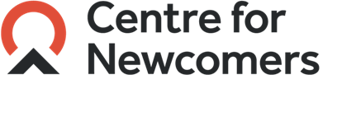
Boost Your Refund!
Tax Time Savings Program
Presented by ATB

Slide 21
What is the Tax Time Savings Program?
How does it work?
Attend a free tax clinic & file your taxes
Tax refund of at least $200?
Living on a low income?
Save $200-$1000 of your refund into an ATB Financial account
Wait one year and earn a 50% match rate, up to $500

Slide 22
Additional Program Details
Attend five financial literacy classes and earn an extra $100
Two savings milestones
June 30th (min. $200 deposit required)
October 31st (top up to $1000)
Cash withdrawals allowed, but may lose match
No final savings goal enforced, although encouraged

Slide 23
Preliminary Results
“It gives me an opportunity to save for a family vacation, something our family has never experienced.”
173 Registrants
72% follow through rate
97% saved min. balance $200
46% balance increase June to Oct.
125 Savers,
$130,872
#prosperwebinar

Slide 24
When given the opportunity, people on low incomes can and do save. - Michael Sherraden
Thank you!
momentum.org
DeanE@momentum.org

Slide 25
Financial Empowerment Coordinator
with the
Sudbury Community Service Centre
jcockburn@vianet.ca
705-560-0430

Slide 26
Many different services
Client-centred, free, un-biased
Helping the client achieve their financial goals, choose the direction that’s best for them
One-on-one budget counseling
Group sessions such as budgeting basics and credit education

Slide 27
“The Successful warrior is the average man, with laser-like focus.”
- Bruce Lee

Slide 28
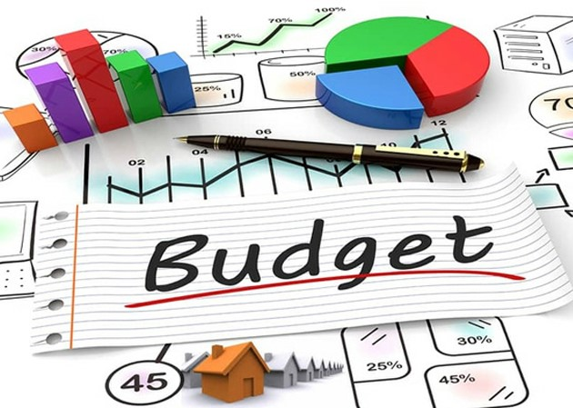
Determine your monthly income
Estimate your monthly spending
Track your monthly spending for two full pay periods

Slide 29
Coffee Shop vs. Home Brew
$2.00 a day vs. $0.67 a day
$720.00 a year vs. $245.00 a year
Savings of $475.00 a year

Slide 30
Pay Yourself First!
Use visual re-enforcement
Save loose change
Set up an automatic savings account
Give yourself an allowance
Wait to make large purchases
Pack a lunch vs. eating out
Make a list and stick to it
Avoid more debt
Tackle current debts

Slide 31
Price matching can save over 10% per shopping trip

Slide 32
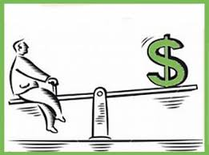
“Watching my kids learn about saving while I did made me realize I had never been taught this skill as a child. I felt like I was preparing them to be an adult.”
“Saving just $50 a month made it possible for Christmas to happen!”
“Building savings became fun and very rewarding.”
“Using cash instead of credit has changed my whole outlook on spending.”
“Not buying lunch with the women at work was hard at first, but soon my savings account was growing. That made it all worthwhile.”

Slide 33
“It is not a daily increase, but a daily decrease. Hack away at the inessentials”
- Bruce Lee

Slide 35
Contact us
Prosper Canada
60 St. Clair Avenue East, Suite 700
Toronto, ON M4T 1N5
(416) 665-2828
www.prospercanada.org
info@prospercanada.org
http://prospercanada.org/newsletter
Dean Estrella
Momentum, Calgary, AB
deane@momentum.org
John Cockburn
Credit Counselling Sudbury, ON
jcockburn@vianet.ca
Glenna Harris
Prosper Canada
gharris
@prospercanada.org
Co-founder and supporter
Notes:
Please subscribe to our newsletter!

