Slide 1
Welcome!
Thank you for joining the webinar on Service design done right: How to get started hosted by Prosper Canada.
The presentation will begin shortly. Audio will begin when the presentation starts.
Technology Details:
For technical assistance, please call GoToWebinar support line 1-855-352-9002.
Participants should connect using VOIP. Please check that the volume is turned up on your computer.
If dial in option is required, please dial in as follows:
Tel (Canada): +1 (647) 497-9416
Access Code: 177-884-331
Toll free option not available
#prosperwebinar

Slide 2
Webinar logistics
Audience members have all been put on “mute” for this webinar
Please share any questions you have using the “Question box” (located at the bottom right side of your screen).
You’ll find a few handouts you can download and refer to during the presentation (located in the control panel at the right side of your screen)
We will share webinar slides with all participants and post a recording of the session within a few days.
#prosperwebinar

Slide 3
Prosper Canada – Who we are
Founded in 1986, Prosper Canada is a national charity dedicated to expanding economic opportunity for Canadians living in poverty through program and policy innovation.
We help service systems and organizations in all sectors to build proven financial empowerment approaches into their businesses in ways that:
Are sustainable
Help them achieve their goals
Tangibly increase the financial well-being of the low-income people they serve.
Prosper Canada’s programming in financial literacy and financial coaching is part of the work of the Prosper Canada Centre for Financial Literacy, co-founded and supported by TD Bank Group.
Notes:
We would like to begin by acknowledging that we are joining you from Toronto which is situated upon traditional territories. The territories include the Wendat (wen-dat), Anishinabek (ah-nish-nah-bek) Nation, the Haudenosaunee (ho-den-oh-sho-nee) Confederacy, the Mississaugas of the New Credit First Nations, and the Métis (may-tee) Nation.
Toronto is in the ‘Dish With One Spoon Territory’. The Dish With One Spoon is a treaty between the Anishinaabe, Mississaugas and Haudenosaunee that bound them to share the territory and protect the land. Subsequent Indigenous Nations and peoples, Europeans and all newcomers have been invited into this treaty in the spirit of peace, friendship and respect.
Today, the meeting place of Toronto is still the home to many Indigenous people from across Turtle Island and we are grateful to have the opportunity to work in the community, on this territory.
We would like to acknowledge and thank everyone on the line, joining us from traditional territories across Turtle Island. We are honoured to be having this discussion with you and thank you for taking the time out of your day to join us.
My name is Glenna Harris, and I am Manager of Learning & Training here at Prosper Canada.
Prosper Canada works with partners in all sectors to ensure that all Canadians, regardless of their income, have access to the financial programs, products, services and advice they need to build their financial well-being.
We envision a future in which all vulnerable Canadians have access to free, high-quality, and unbiased financial information, education, coaching or counselling when they need it. We believe bringing innovative research and design solutions to this work, such as a ‘service design’ approach, to be part of this vision.
Prosper Canada’s programming in financial literacy is part of the work of the Canadian Centre for Financial Literacy, co-founded and supported by TD Bank Group.
Prosper Canada works with partners in all sectors to ensure that all Canadians, regardless of their income, have access to the financial programs, products, services and advice they need to build their financial well-being.
We aim build financial empowerment solutions that are sustainable and help service systems and organizations in all sectors to achieve their goals.

Slide 4
Today’s presentation (12:00-1:00pm)
Welcome and introduction
Service design – Bonnie Tang and Minyan Wang (Bridgeable)
Improving the Benefits Screening Tool – Trisha Islam (Prosper Canada)
Q&A
Notes:
We have an exciting presentation planned for you today.
As all of us work in our different parts of the field to improve the lives of Canadians, I’m sure we’re all always looking for ways to improve how we design and deliver our programs. As always, solutions can range from very complex to very simple.
Our goal today is to introduce you to what service design is, how it works, and what elements of service design you can take and apply to your own work. It’s even possible that you are already working from a service design approach and don’t even realize it!
First, you’ll hear from experts at Bridgeable, who will share with us how they approach service design and why it is so crucial to use service design principles when developing people-oriented solutions.
Bridgeable is an award-winning service design consultancy located in Toronto, whose work spans multiple industries, including healthcare, financial services, transit, and more. Bridgeable works with organizations to create more human experiences.
And second, did you know that our very own Benefits Screening Tool was developed using service design principles?
We’ll hear from Trisha Islam who manages the Benefits Screening Tool project here at Prosper Canada, on how we used service design to refine this tool and make it something that will be truly beneficial to the lives of individuals.
We’ll hold some time at the end for Q&A, so please let us know in the question box at any time if you have specific questions that Bonnie, Minyan, or Trisha can answer

Slide 5
1. Introductions: Our speakers
Bonnie Tang
Manager, Design Strategy
Bridgeable
bonnie.tang
@bridgeable.com
Minyan Wang
Sr Designer, Biomedical Communications
Bridgeable
minyan.wang
@bridgeable.com
Trisha Islam
Senior Officer, Program Delivery and Integration
Prosper Canada
tislam
@prospercanada.org
Notes:
We are very excited to introduce our panel of speakers to you today!
Bonnie Tang
Manager, Design Strategy
Bonnie has an interest in translating complex problems into user-focused stories. Her MSc degree in Biomedical Communications from the University of Toronto equipped her with visual and communication skills that translate creative design strategies through service design. She leads multidisciplinary teams on an array of projects, from conceptualization to final product and implementation. Whether it’s communicating treatment decision pathways or translating user insights into strategic visions, her ability to draw connections at all levels of a complex system delivers innovative solutions in our work.
Minyan Wang
Sr Designer, Biomedical Communications
Minyan is dedicated to designing engaging and immersive learning experiences that communicate complex concepts. She plays a key role in projects focusing on science education and has led designs for innovative training and messaging solutions. She has worked extensively with faculty at the University of Toronto and physicians at The Hospital for Sick Children to develop teaching and training materials. Minyan holds a MSc degree in Biomedical Communications from the University of Toronto, and a BSc and BCompSc (general) degree from Queen’s University.
Trisha Islam is a Senior Program Delivery and Integration Officer at Prosper Canada.
She has worked on projects related to improving access to tax-filing, government benefits, financial coaching, and financial literacy for people living on low incomes in Canada.
Currently, she leads the Benefits Screening Tool project and its various pilots in healthcare and the social services sector.
Glenna Harris – I am Manager of Learning & Training here at Prosper Canada, responsible for our financial education programming and learning resource development – including events such as this.

Slide 6
Tell us more about you!
What experience have you had with service design already?
What part of the field do you work in?

Slide 7
All about service design
Service design is a methodology that asks designers of programs, services, or products to:
1
Better understand clients and organizations
4
Empathize with pain points
2
5
Create evidence-based solutions
Examine assumptions
3
Discover more about people’s experiences
6
Address problems
Notes:
Today’s webinar is a little different from some others we’ve done in the past – we love to bring you examples of program implementation in the field of financial empowerment, and the types of solutions that are already in action in Canada – and we’ll continue to do so!
But today we’re talking more about ways to get to those program solutions in the first place, and this is what service design is about.
Service design is a human-centred design method that helps improve understanding of all the different stakeholders in order to design programs, services, or products that best reflect their experiences and meet their needs – so it will frequently engage not just the staff involved but also clients, managers, funders, and other relevant stakeholders in the community.
This involves approaching program design questions from a place of empathy, but also a willingness to examine assumptions about what’s working well, and what could be improved.
Service design addresses how an organization gets something done. It ensures services are usable, desirable, and creates positive outcomes.
By empathizing and seeking to better understand stakeholder pain points, we can then design programs and resources through evidence-based solutions that create “win-win” interactions between service users and service providers.
Our speakers are going to tell us more about some examples like that – both within business-oriented environments but then also within social sector and health care environments. It’s a process that can involve a lot of different types of steps, and does typically involve some investment of time and resources in order to do it right. You’ll hear terms like “journey map” and “service blueprint,” that are common types of service design activities.
There may sometimes be limits to what we can change, but even small solutions that are designed to minimize pain-points and are based in evidence, can make a difference.
On that note, I’m going to turn the presentation over to Bonnie and Minyan from Bridgeable, who will kick us off by telling us more about why service design is so important and the reasons why more companies and organizations are using it as part of their work.
Bonnie and Minyan, over to you!

Slide 8
Over to Bridgeable!

Slide 9
Improving the Benefits Screening Tool
Trisha Islam

Slide 10
The problem we wanted to address
The problem
There are strong causal linkages between poverty and poor health.
The most effective prescription is more income.
The idea
Screening for benefits eligibility +
Hands-on assistance with tax-filing and applying for benefits →
Boost incomes.

Slide 11
The Benefits Screening Tool (BST)
Paper-based
Online
2
2
Doctors at St. Michael’s Hospital, the University of Toronto, and the Ontario College of Family Physicians made a paper-based tool.
Prosper Canada partnered to develop an online version and piloted it in Ontario and Manitoba.

Slide 12
The Benefits Screening Tool (BST) Phase 2
Identify necessary enhancements
Better understand the benefits system, patients, and healthcare providers
Build the resources and training materials needed to successfully integrate and use the BST

Slide 13
Why we chose Service Design
Engage diverse stakeholders
Learn more about patients and healthcare providers using a human-centric approach
Service Design
Co-create with users when designing solutions
Prototype specific tool features and supports that people may need

Slide 14
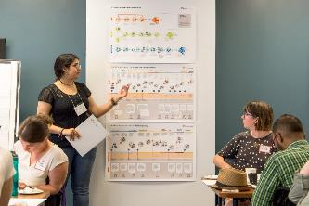
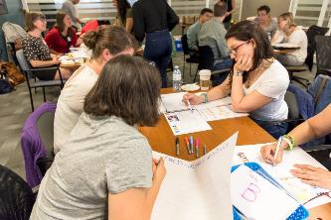
Our project goal
Enable healthcare providers to help patients with low incomes identify and access income benefits they may be eligible for, but not receiving.

Slide 15
Research questions
1. Can we develop a typology for benefits and how
they are accessed?
2. What do people living with low incomes experience
when applying for benefits?
3. Who is best placed in the healthcare setting we
explored to administer the BST and help patients
navigate benefit application processes?
4. How can we improve the BST tool to improve people’s
experience when accessing benefits?

Slide 16
What we did: Reviewed application processes for 60+ federal, Ontario, and City of Toronto income-related benefits.

Slide 17
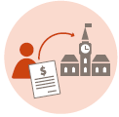
What we did: Reviewed application processes for 60+ federal, Ontario, and City of Toronto income-related benefits.
What we found:
There are easy, moderate, and complicated pathways to accessing benefits
The healthcare sector plays a major role in helping people access government benefits
Benefit pathways involving healthcare professionals are always moderate or complicated

Slide 18
What we did: Interviewed 14 people with low incomes to ask about their experiences when applying for government benefits.

Slide 19
What we did: Interviewed 14 people with low incomes to ask about their experiences when applying for government benefits.
What we found:
There are significant challenges and pain points for people trying to access government benefits, such as the Ontario Disability Support Program (ODSP).

Slide 20
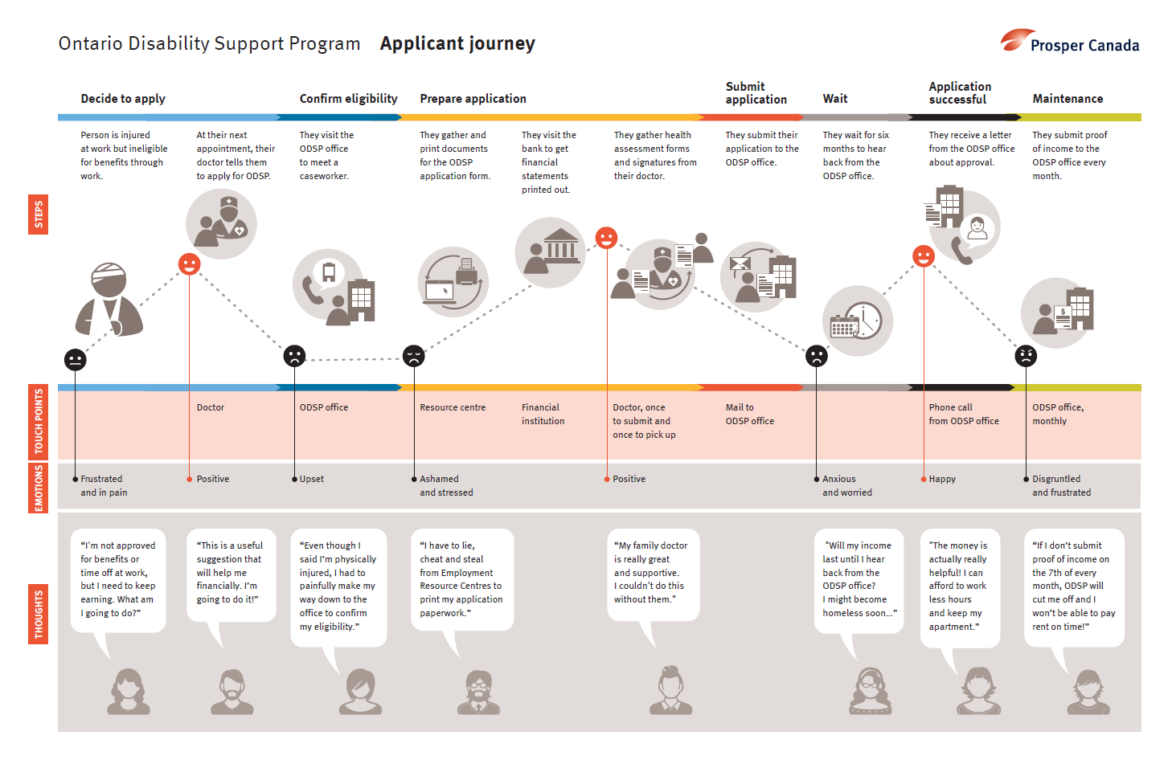
Using journey maps

Slide 21
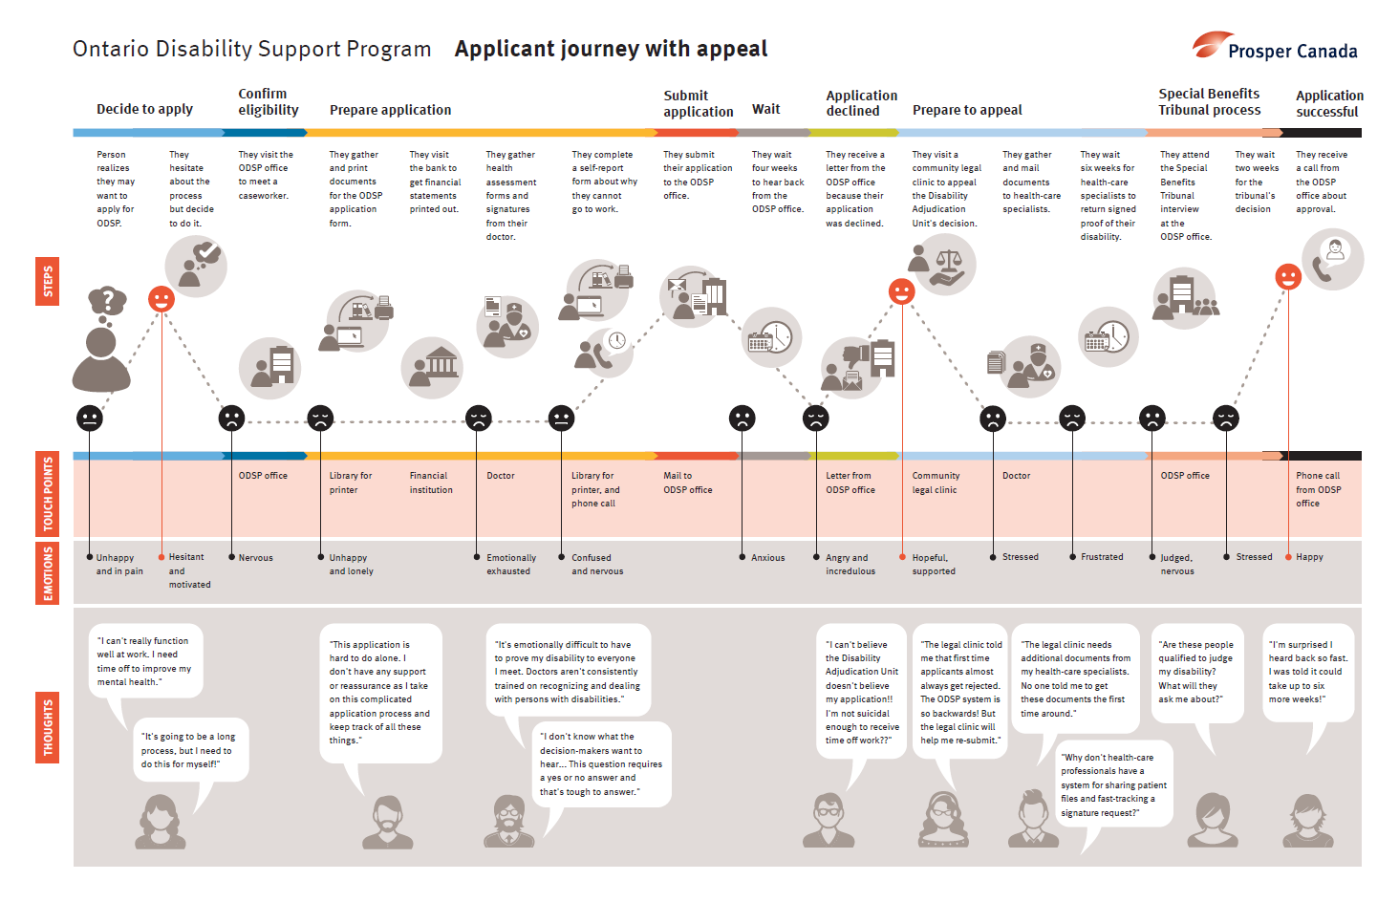
Using journey maps

Slide 22
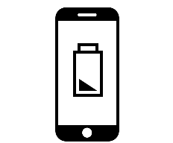
We discovered different “archetypes” of benefit applicants
Confident Advocate
Nervous Applicant
Low Energy Applicant
Discouraged Applicant

Slide 23
What we did: Conducted 12 interviews with different healthcare practitioners and explored their role in helping patients to access benefits.

Slide 24
What we did: Conducted 12 interviews with different healthcare practitioners and explored their role in helping patients to access benefits.
What we found:
Doctors are integral
Busy, important to keep in service flow but cannot guide patients through applications
Settlement worker or equivalent is best placed as a benefits navigator
Already spends time talking to patients about money

Slide 25
What we did: Conducted 14 interviews with people living on low incomes and one focus group with 13 healthcare practitioners.

Slide 26
What we did: Conducted 14 interviews with people living on low incomes and one focus group with 13 healthcare practitioners.
1
2
3
We walked people through the website and current benefits screening process.
We captured their feedback about what they liked and disliked, and suggestions for improvement.
Based on feedback, we made three significant changes to the tool.

Slide 27
What we did: Conducted 14 interviews with people living on low incomes and one focus group with 13 healthcare practitioners.
Feedback: Practitioners found questions awkward, formal, and long.
Our response:
Reframed screening
questions in plain language.

Slide 28
What we did: Conducted 14 interviews with people living on low incomes and one focus group with 13 healthcare practitioners.
Feedback: Practitioners found questions awkward, formal, and long.
Our response:
Reframed screening
questions in plain language.
Feedback: Patients wanted a benefits printout to be friendly, accurate, and easy to follow.
Our response:
Added small behavioural and technical elements.

Slide 29
What we did: Conducted 14 interviews with people living on low incomes and one focus group with 13 healthcare practitioners.
Feedback: Practitioners found questions awkward, formal, and long.
Our response:
Reframed screening
questions in plain language.
Feedback: Patients wanted a benefits printout to be friendly, accurate, and easy to follow.
Our response:
Added small behavioural and technical elements.
Feedback: Both groups found the benefits process frustrating and challenging, and isolating.
Our response:
Connected with Findhelp to connect with local resources.

Slide 30
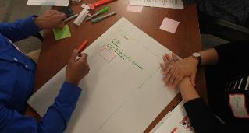
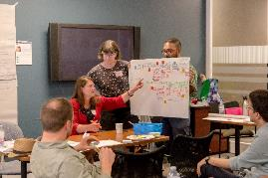
What we did: Convened diverse stakeholders to jointly understand benefit access problems, generate insights, and help design possible solutions.
Day One
Day Two
Co-created a service flow in a Community Health Centre setting.
Co-created the improved website and new features.

Slide 31
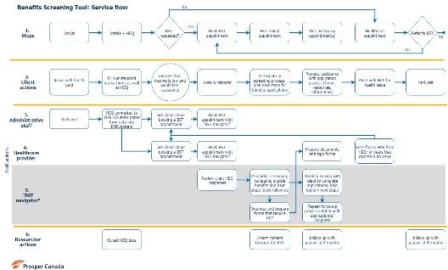
What we did: Convened diverse stakeholders to jointly understand benefit access problems, generate insights, and help design possible solutions.
We used co-creation insights to develop a service blueprint.

Slide 32
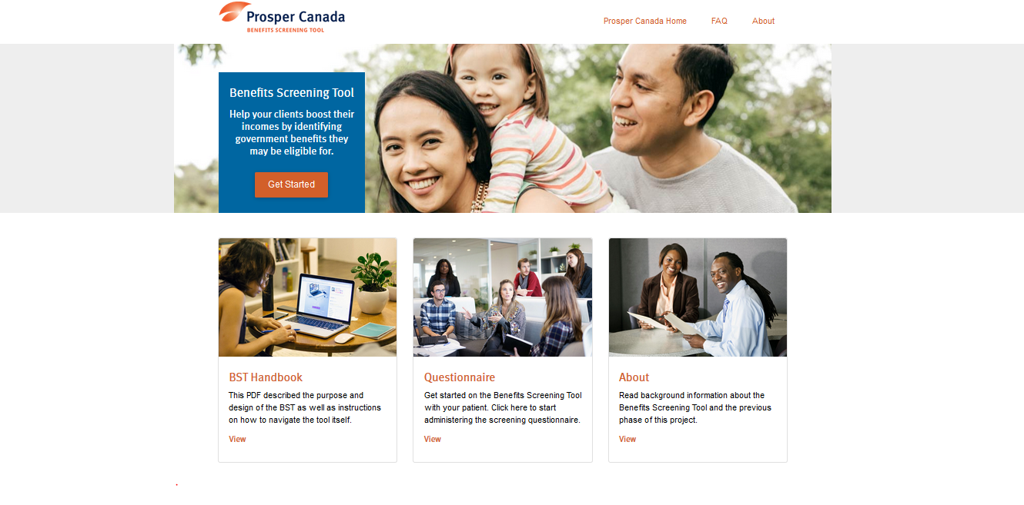
What did service design help us do?
Better understand benefit application processes
Gain deep knowledge about experiences of patients living on low incomes and the healthcare providers who support them.
Enhance the tool so that it:
had user-friendly features and functionalities
easy access to government applications and local resources
Develop a service integration model for frontline healthcare delivery

Slide 33
Insights for non-profits
Service design is a valuable methodology for designing programs because it keeps both the user and service provider in mind.
However, service design also requires human and financial resources.
Service design requires the collaboration of all key stakeholders.
Service design works well when organizations are committed to a client-centred approach.

Slide 34
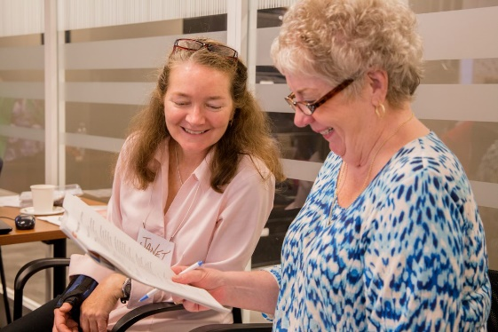
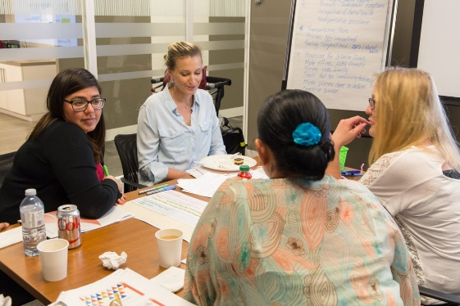
Other tips for getting started
Learn more! Free online resources, blogs, and articles
Give it a try – service design does not have to be complicated or costly

Slide 35
The Benefits Screening Tool Project – Phase 2 is funded by the Maytree Foundation, the Canadian Institutes of Health Research and St. Michael’s Hospital Foundation.
This project is a collaboration with Dr. Andrew Pinto, a family physician and founder of The Upstream Lab at The Centre for Urban Health Solutions, Li Ka Shing Knowledge Institute, St. Michael’s Hospital.

Slide 37
Questions answered offline
1. How do you engage action-oriented people who may not think SD is helpful in getting things done?
Depending on the reason why these individuals might not think Service Design is helpful, there are a few ways that we can help them understand the value of SD. If time is a concern, design process can be scaled to accommodate for different timeline and scope. Taking the upfront time to understand the needs of everyone involved in a service can also help save time later. Understanding needs enables companies to make investment (time or money) in a direction that will resonate with the people involved in a service.
As well, Service Design can minimize the risk of only finding out after roll-out that something doesn’t work. It takes those who are designing a service through the upfront steps necessary to ensure that the actions they do take are ones that are most likely to succeed. In a nutshell, our advice is to highlight the flexibilty of the service design process, have a discussion with this person/people to understand what their main concerns are with the process, and identify the downstream value that this process can deliver on.

Slide 38
Questions answered offline
2. Would this process be helpful for curriculum design as well?
Yes definitely! Teaching and learning are all very human experiences that require a deep understanding of both the learner and educators’ needs. A curriculum can be thought of as a service. The learning materials and instructors who might be delivering the materials can be thought of as the front-of-house.
A big part of designing an engaging and effective curriculum is understanding learner needs. Service Design methodologies can be used to understand needs around learning objectives, learning styles, format preference, and the context in which learners prefer to receive this education. Looking at the back of house, service design can be used to understand what the educator needs in order to successfully deliver a curriculum. This can include things like training, peer-to-peer discussions, and educator-specific tools. By going through the Service Design process, a curriculum can be designed so that it’s engaging and effective for the learner, while setting up the educators up for success in delivering it.

Slide 39
Thank you for joining us!
We will be sending you an email soon with:
Slides from today’s webinar
Link to webinar recording
Link to post-webinar survey
We will also post the recorded webinar on our Learning Hub:
https://learninghub.prospercanada.org/webinars/

Slide 40
Prosper Canada
60 St. Clair Avenue East, Suite 700
Toronto, ON M4T 1N5
(416) 665-2828
www.prospercanada.org
info@prospercanada.org
http://prospercanada.org/newsletter
Bonnie Tang
Manager, Design Strategy
Bridgeable
bonnie.tang@bridgeable.com
Trisha Islam
Senior Officer, Program Delivery and Integration
Prosper Canada
tislam@prospercanada.org
Minyan Wang
Sr Designer, Biomedical Communications
Bridgeable
minyan.wang@bridgeable.com
Glenna Harris
Manager, Learning & Training
Prosper Canada
gharris
@prospercanada.org
Notes:
Please subscribe to our newsletter

